Slide 1


Data Analysis
Trainity:-Project-2
Instagram User Analytics

Slide 2


Approach
In this Instagram User Analytics Project, our focal point revolves around dissecting user activities. This is achieved through the utilization of a dataset graciously provided by Instagram. Employing SQL as our analytical tool, we navigate the dataset to extract pertinent insights that address the client's inquiries.

Slide 3

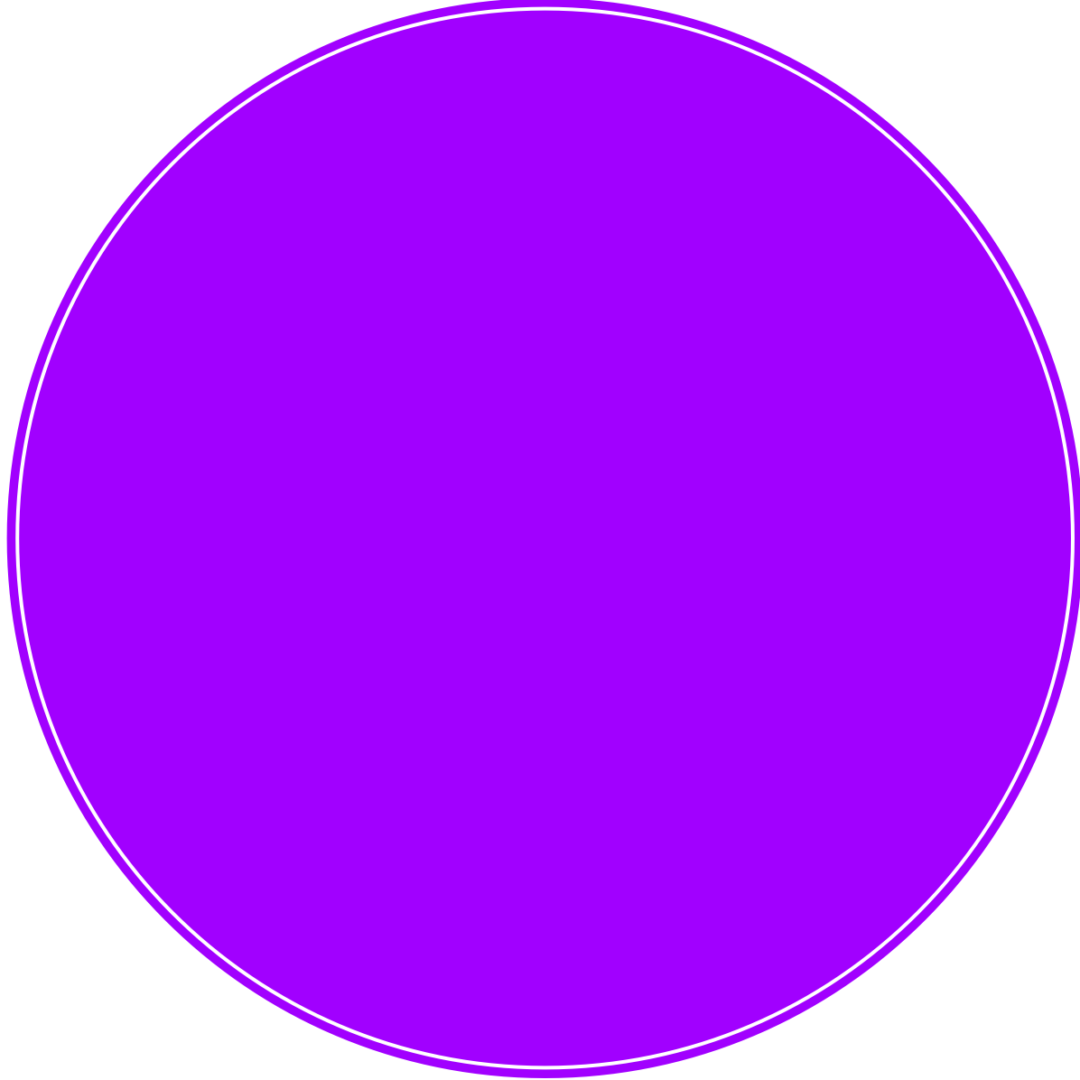
In this project we are doing an in-depth exploration of user interactions and engagement with the Instagram app. we aim to unearth insights that catalyse informed decision-making across various business functions.
We are going to achieve this by doing these tasks:
Marketing Analysis
Investor Matrics
Project Recap

Slide 4
Loyal User Reward
Inactive User Engagement
Contest Winner Declaration
Hashtag Research
AD Campaign Launce
Marketing Analysis

Slide 5
Investor
Metrics
User Engagement
Bots & Fake Accounts

Slide 6
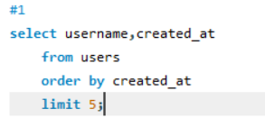
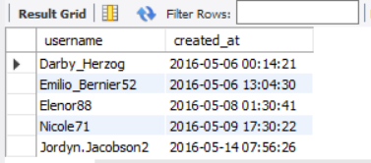

Marketing Analysis
Loyal User Reward:-
The marketing team wants to reward the most loyal users, i.e., those who have been using the platform for the longest time.

Slide 7
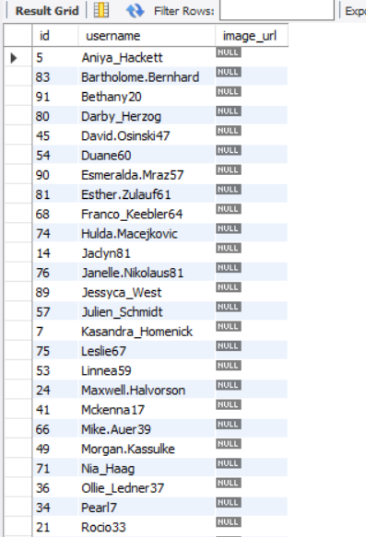
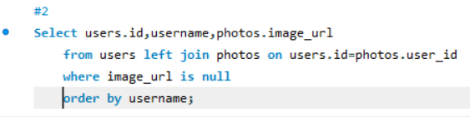
Marketing Analysis
Inactive User Engagement:-
The team wants to encourage inactive users to start posting by sending them promotional emails.

Slide 8
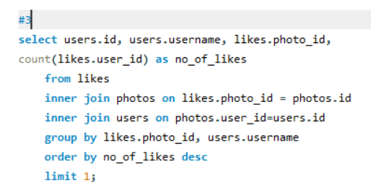

Marketing Analysis
Contest Winner Declaration:-
The team has organized a contest where the user with the most likes on a single photo wins.

Slide 9
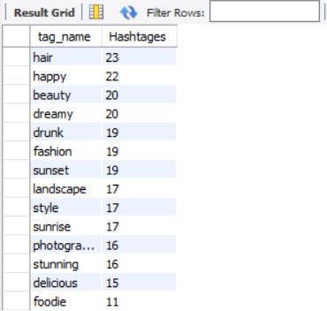
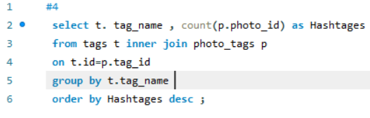
Marketing Analysis
Hashtag Research:-
A partner brand wants to know the most popular hashtags to use in their posts to reach the most people.

Slide 10
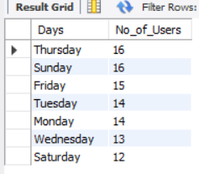
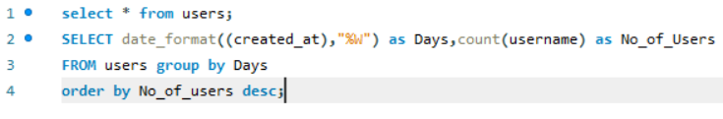
Marketing Analysis
Ad Campaign Launch:-
The team wants to know the best day of the week to launch ads.

Slide 11
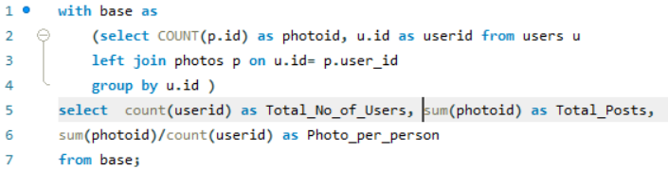

Investor Metrics
User Engagement:-
Investors want to know if users are still active and posting on Instagram or if they are making fewer posts..

Slide 12
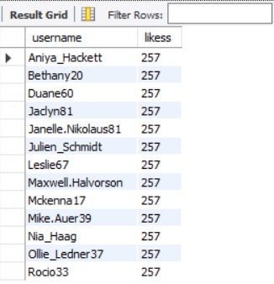
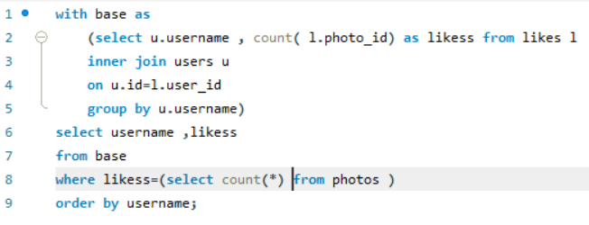
Investor Metrics
Bots & Fake Accounts:-
Investors want to know if the platform is crowded with fake and dummy accounts.

Slide 13


Tech-Stack Used
Our analysis was conducted using the latest version, MySQL Workbench 8.0.34.0, renowned for its up-to-date features. Additionally, SQL Server Management Studio played a pivotal role. To present our findings effectively, we employed Microsoft PowerPoint, ensuring a polished and comprehensible delivery.
INSIGHT
Through meticulous data analysis, a remarkable revelation emerged: 'ZACK_KEMMER97' holds the record for the highest number of likes on a single post. Furthermore, our insights unveiled the predominant use of tags such as 'Hair,' 'Happy,' 'Beauty,' 'Dreams,' and 'Drunk' by users. Leveraging this knowledge, we propose fostering user engagement by orchestrating events cantered around these themes.
Summary

Slide 14
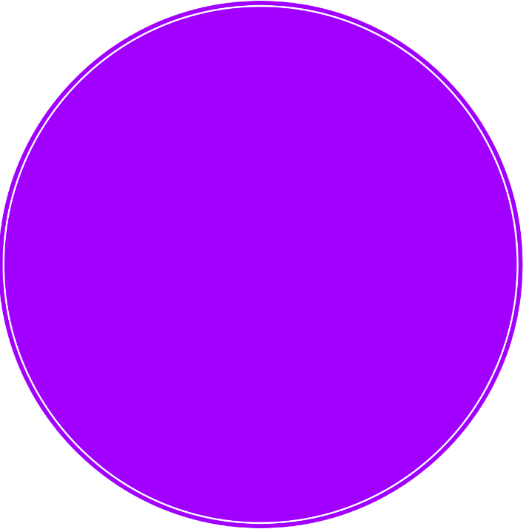
Thank you!
ANY QUESTIONS?

